Slide 1

Break out of the browser with
TensorFlow.js
Erik-Berndt Scheper
Edwin Derks

Slide 2
Introduction - Let’s meet
Erik-Berndt Scheper
CodeSmith @ Ordina JTech
Contracted by Ministry of Justice and Security
Passion for Big Data technologies & Machine learning
Edwin Derks
CodeSmith @ Ordina JTech
Contracted by BMW Group
Independent Developer Advocate for Jakarta EE

Slide 3


Agenda
Introduction
Hands-on Lab - part one
Intermezzo
Hands-on Lab - part two
Feedback & wrap-up
https://pixabay.com/p-683065/

Slide 4

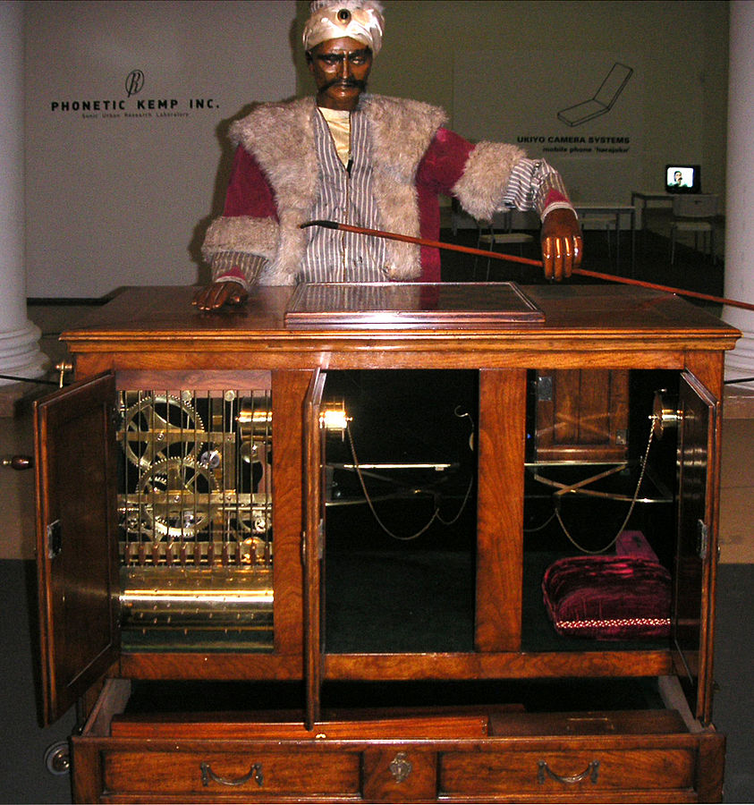
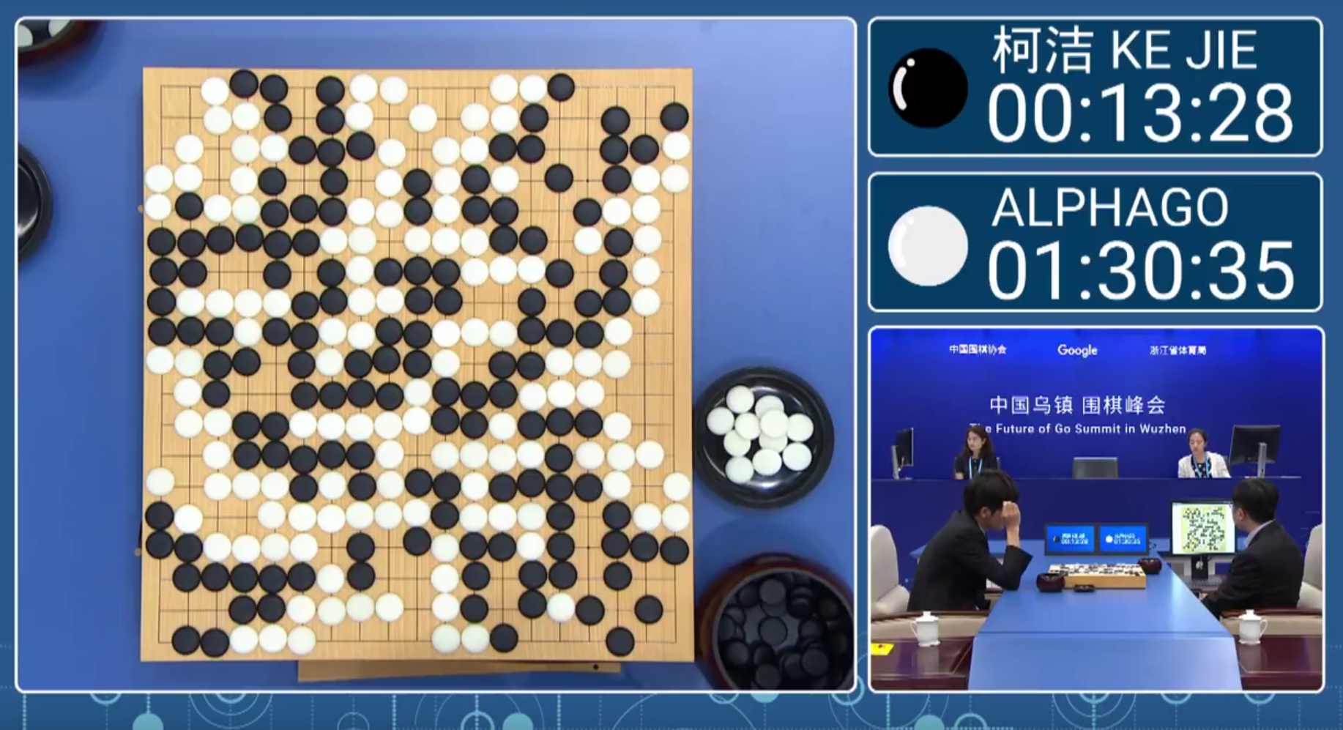
Machine learning… the past
Alan Turing
1959
Notes:
Term ‘Machine Learning’ was coined in 1959 —> based on a paper by Alan Turing
A few ML examples from the past
“Skynet” a fictitious neural network from ‘Terminator’ franchise (scary, turned agains humans)
“The Mechanical Turk” (18th century) was not a ‘robot’, but a human, hidden inside the machine
Alpha-Go - real ML, defeated the world champion in Go - ‘impossible’ with brute force

Slide 5
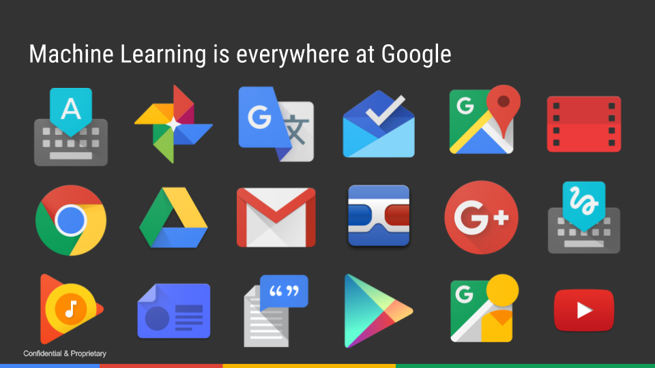
Machine learning… the present
Notes:
The Present
It’s everywhere ?!
At Google, Amazon, Apple, Tesla, …

Slide 6

Machine learning… the future ?!
Notes:
The future ?!
We can build it, with TensorFlow !
How?
Python
JavaScript

Slide 7
TensorFlow
Google DeepBrain library for ML since 2011
Open sourced in 2015
Tensor = multidimensional data array (in math…)
Hardware: TensorFlow Processing Unit since 2016

Slide 8
TensorFlow.js
Started out as deeplearn.js using WebGL
Most TensorFlow API bindings supported
Develop using JavaScript, TypeScript and Node.js
Imports TensorFlow(.js) and Keras models
Runs almost everywhere!
Local data storage, no need to deploy

Slide 9

Tensorflow(.js) is all I need?
Yes, but …
It is a tool to achieve your goals
Your parameters matter!
Quality of input data
Quality and amount of your verification data
Configuration of your neural network

Slide 10
The good, the bad and the ugly
The good ?!
Easy to get into (due to .js) and prototype
Import TensorFlow and Keras models
Local data storage and processing (GDPR!)
TensorBoard support recently added
The bad
Performance is slower than Python
The ugly
Javascript ?!

Slide 11

Agenda
Introduction
Hands-on Lab - part one
Intermezzo
Hands-on Lab - part two
Feedback & wrap-up
https://pixabay.com/p-683065/

Slide 12
Hands-on Lab - part 1
# 1. Install NodeJS (if you haven’t already done so ...)
# 2. Clone GIT repository
$ git clone https://github.com/fbascheper/tensorflow-js-workshop
$ npm install
# 3. Run npm install AND (as always) - ignore npm warnings
$ cd tensorflow-js-workshop
$ npm install
# 4. Follow the instructions in “docs” or online at
https://github.com/fbascheper/
tensorflow-js-workshop/blob/master/docs/instructions.md
# 5. We’re here to HELP - if you need it.
There’s an intermezzo - a few more sheets - after assignment 3.

Slide 13
Agenda
Introduction
Hands-on Lab - part one
Intermezzo
Hands-on Lab - part two
Feedback & wrap-up
https://pixabay.com/p-683065/

Slide 14

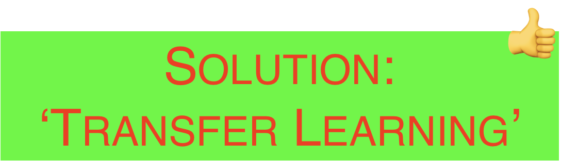
What’s the problem?
ML IS COMPLICATED
& TIME CONSUMING !
https://pixabay.com/nl/photos/wanhoop-alleen-archetype-archetypes-513529/
Notes:
Machine Learning - what’s the problem?
ML is complicated !
ML is slow !
Of course, we could train a model from scratch…
Requires experience and time
—> Solution: transfer learning !

Slide 15
Transfer learning
Use a ‘pre-trained’ model
Trained on a large dataset
Will effectively serve as a ‘generic model’ of the visual world
Available pre-trained models:
https://github.com/tensorflow/tfjs-models
Two scenario’s
Feature extraction
Fine-tuning

Slide 16
Feature extraction vs fine-tuning
Feature extraction
Using the entire model
Or the convolutional base
Fine tuning
Unfreeze top layers
And jointly train
newly added classifier layers
And the last layers of the frozen mode
Notes:
Feature extraction
—> Add a NEW classifier on top of the model, or on top of the convolutional base
—> Works best if the new classifier is ‘sufficiently alike’ the original classifiers
Fine tuning
—> Unfreeze the last set of layers
—> Jointly train those layers with our new classifier

Slide 17
Feature extraction vs fine-tuning
Feature extraction
Using the entire model
Or the convolutional base
Fine tuning
Unfreeze top layers
And jointly train
newly added classifier layers
And the last layers of the frozen mode
Notes:
In this application, we’ll create a 2-layer fully connected model
—> Feature extraction on top of the entire (MobileNet) model
By creating a separate model, rather than adding layers to the mobilenet model
we "freeze" the weights of the original MobileNet model
and only train weights from the new model.
Much faster than building and training a model from scratch!

Slide 18
Next steps?
Create a 2-layer fully connected model.
Layer 1 - MobileNet model
Layer 2 - Newly trained model using webcam images
Effective result
The weights of the mobilenet model are ‘frozen’
Predictions based on the weights of the connected model
Much faster than building and training a model from scratch!

Slide 19
Agenda
Introduction
Hands-on Lab - part one
Intermezzo
Hands-on Lab - part two
Feedback & wrap-up
https://pixabay.com/p-683065/

Slide 20
Hands-on Lab - part 2
# 1. Go ahead with the instructions in “docs” or online at
https://github.com/fbascheper/tensorflow-js-workshop/blob/master/docs/instructions.md
# 2. We’re still here to HELP - if you like.

Slide 21
Agenda
Introduction
Hands-on Lab - part one
Intermezzo
Hands-on Lab - part two
Feedback & wrap-up
https://pixabay.com/p-683065/

Slide 22
Feedback ?!
Email
Erik-Berndt.Scheper@Ordina.nl
Edwin.Derks@Ordina.nl
Twitter
@fbascheper

Slide 23

https://commons.wikimedia.org/wiki/File:Thank-you-word-cloud.jpg

